Slide 1

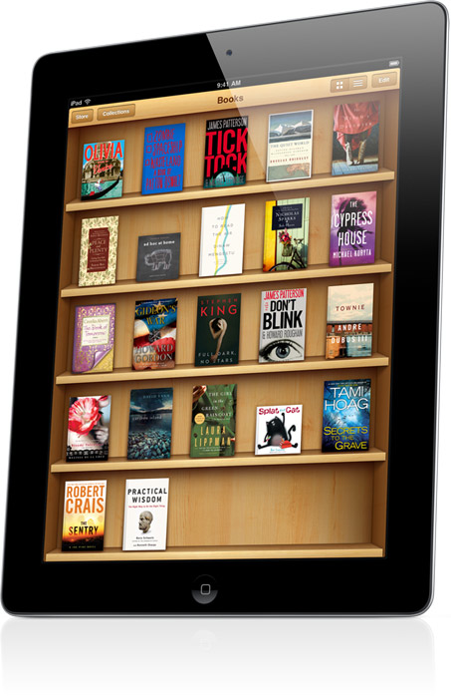

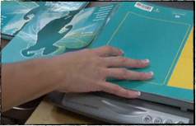

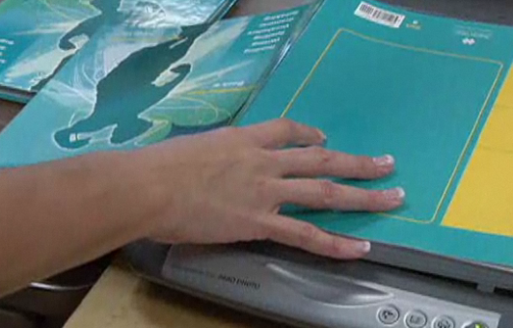
Advanced Applications in
Digital Texts
Samuel Sennott & David McNaughton
The Pennsylvania State University

Slide 2
Consider Sarah
Sarah, 13 Years old
Struggles to read fluently with comprehension and often has difficulty with vocabulary
Desires to stay in general education curriculum
Frustrated by the amount of reading required in classes
http://www.flickr.com/photos/434pics/3750563321
Notes:
Let’s consider a student.

Slide 3
DOIT! | SETT
Describe goal | Student? Environment? Task?
Outline alternatives | Tools?
Identify needed resources and impact -cost? -training(student and team)
Take action -select technologies -identify responsibilities -collect data
! Celebrate progress and success
Notes:
We can use two similar frameworks to help us consider digital texts. DOIT and SETT.

Slide 4
DOIT!: Describe goal
SETT
  Student
  Environment
  Task
For Sarah to be able to access the texts in her curriculum with comprehension.
Notes:
In DOIT we first describe the goal. This compares to the SETT’s first three parts.

Slide 5
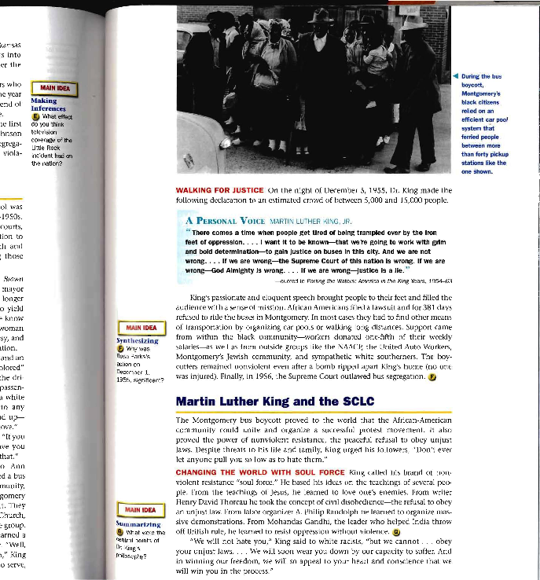
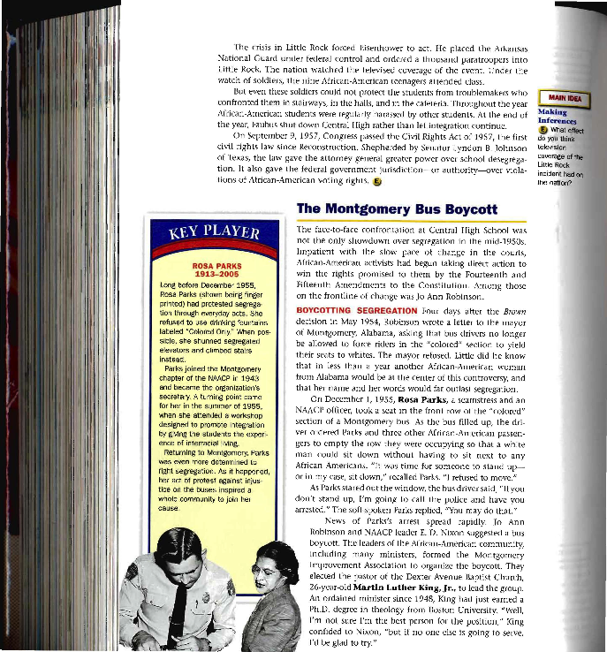
Sample Social Studies Text
Notes:
Here we have a representative social studies text.

Slide 6
Comprehension
Definition: Comprehension is deriving meaning from text.
  Understanding meaning in the proper context
  Integration of old and new information
  Understanding the author or speaker purpose
Standards
  Common Core Standards for Reading (pg. 10):
    1. Read closely to determine what the text says explicitly and to make logical inferences from it; cite specific textual evidence when writing or speaking to support conclusions drawn from the text.
    2. Determine central ideas or themes of a text and analyze their development; summarize the key supporting details and ideas.
Notes:
The primary goal is comprehension. As Sarah struggles with parts of the reading process, she is receiving instruction to assist her. Yet, when she needs to process text for content and comprehension, she may need to utilize assistive technology.

Slide 7
Reading Comprehension Strategies
Pressley (2000)
1 | Decoding skills
2 | Vocabulary knowledge
3 | World knowledge
4 | Active use of comprehension strategies
5 | Monitor comprehension
Notes:
Explain

Slide 8
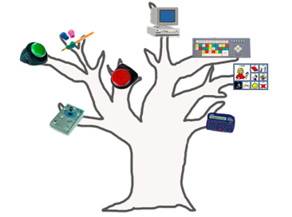
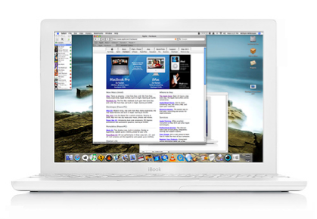
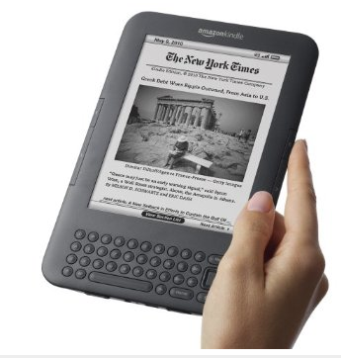

DOIT!: Outline alternatives
SETT: What Tools?
Notes:
To aid in the goal of reading comprehension we must choose from a range of alternatives. We narrow our search towards digital text tools.

Slide 9
Digital Texts Can Provide Support for:
Component | Digital Text Feature
Decoding | Text‐to‐speech
Vocabulary | On‐board dictionary
World knowledge | Adapted text
Active comprehension strategies | E‐coaching
Monitor comprehension | Built in Note-taking
Notes:
We can match support for the comprehension strategies mentioned through various digital text features.

Slide 10


Why use digital texts?
Digital texts are more
  flexible,
  accessible,
  versatile
Digital texts are a key element of Universal Design for Learning (UDL)

Slide 11
Digital Texts as Universal Design for Learning (UDL)
Universal Design for Learning Guidelines
1. Provide Multiple Means of Representation
2. Provide Multiple Means of Action and Expression
3. Provide Multiple Means of Engagement
Notes:
What is UDL?

Slide 12
Multiple Means of Representation
Digital Texts can
Provide options for customizing the display
Offer auditory and visual options
Clarify vocabulary and symbols
Options for multi-media
Provide options for comprehension

Slide 13

Digital text is Flexible
You can change the:
text size
text color
text font
You can make the text speak
+ Add vocabulary support
etc.

Slide 14
Digital text can
be displayed on computers and mobile devices
be displayed in various ways (color, font, etc…)
be turned into Braille
be read aloud with text to speech
include structural and semantic tags for navigation and organization
include embedded learning supports (like help using comprehension strategies or vocabulary support)
From CAST

Slide 15
Digital Text Options
Outline Alternatives and
  Identify Needed Resources and Impact
User created
User scanned
Internet documents
Consumer formats
Repository documents
Notes:
As we talk about the alternatives, we will also identify needed resources to actually use the alternative discussed

Slide 16
Digital Text Options
Type of Resource | Description | Benefits | Limitations | Resources
Creating your own text | Creating digital texts from various resources such as adapting text books or web articles. | Can create with familiar software Highly customizable and flexible. Often times software is already owned or free option is available. | Can be time and labor intensive Copyright concerns Relies on customized accessibility planning. | PowerPoint + PowerTalk, fullmeasure.co.uk/powertalk MS Word and Word Talk, wordtalk.org.uk Tarheel Reader www.tarheelreader.org Bookbuilder, //bookbuilder.cast.org
Scanning your own text | Using an optical scanner to convert paper based texts to a digital format. | Enables the conversion of print based texts to a digital format. May already own the paper text. Robust software can be used to both scan and access the text. | Can be time and labor intensive Can produce imperfect results Software can be expensive | Kurzweil 3000, www.kurzweiledu.com Read and Write Gold, www.texthelp.com
Digital texts on the Internet | Using web content such as an article that is already in a digital format. | Often times web based texts and articles are free. Already in a digital format. Newest search tools make finding resources easier | Formatting may be relatively fixed (ex. series of web pages) Key content such as textbooks may not be available. | Wikipedia, www.wikipedia.org Scholastic News, www2.scholastic.com/browse/scholasticNews.jsp National Geographic Kids, www.kids.nationalgeographic.com
Digital texts in consumer formats | Using software or web based tools to download and access books. | Texts are available on software that is widely available and free Inclusion factors Some accessibility features are built into the software and hardware platforms | Limits on accessibility features depending on hardware the books are being read on. Many texts cost money and have limitations on sharing/ recycling. | Kindle, https://kindle.amazon.com Nook, www.barnesandnoble.com/nook iBooks, www.apple.com/ipad/built-in-apps/ibooks.html
Digital text repository | Using digital texts from a text repository providing texts that are open to the public or are provided to individuals with qualifying disabilities. | A large amount of texts are available Texts can be obtained quickly Some repositories are free or free for individuals with qualifying disabilities Flexible formats are often available Free software is sometimes available to access texts. | Bureaucracy of signing up to participate in repository Often times pictures/ photos are excluded from these formats | Bookshare, www.bookshare.org Project Gutenberg, www.gutenberg.org The Accessible Book Collection, www.accessiblebookcollection.org

Slide 17
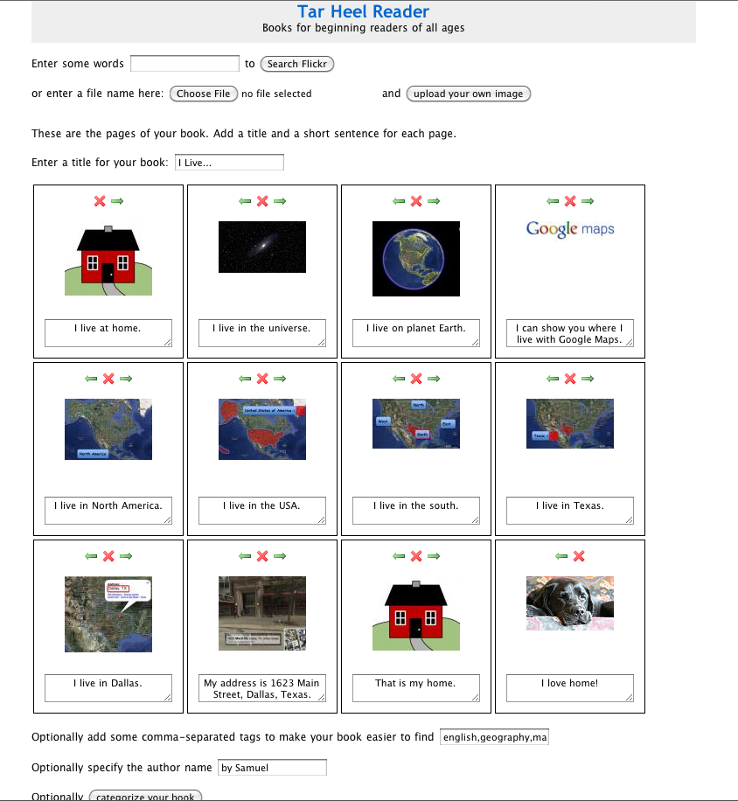


1) Creating your own text
word
powerpoint
Tar Heel Reader
UDL Bookbuilder

Slide 18
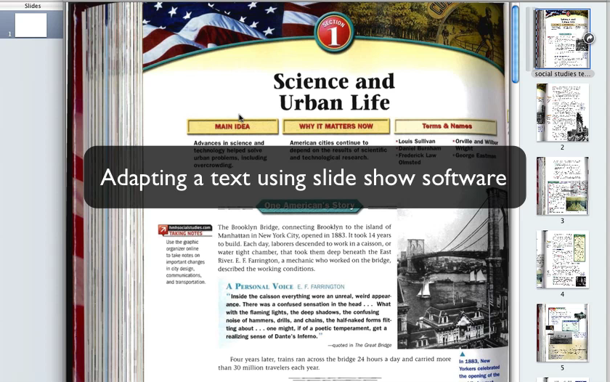
Creating your own text with slide show software

Slide 19
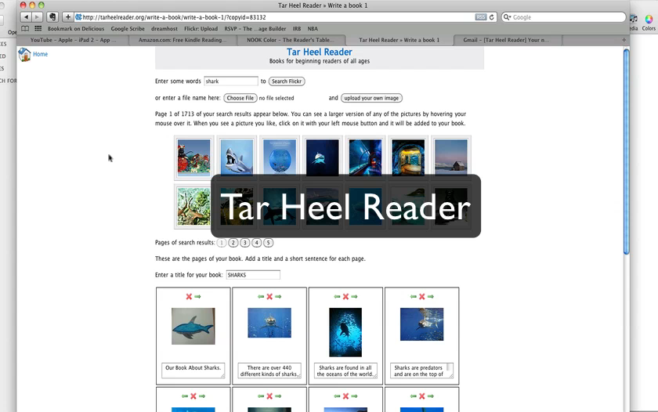
Tar Heel Reader

Slide 20
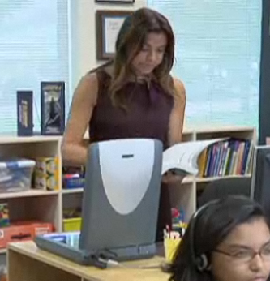
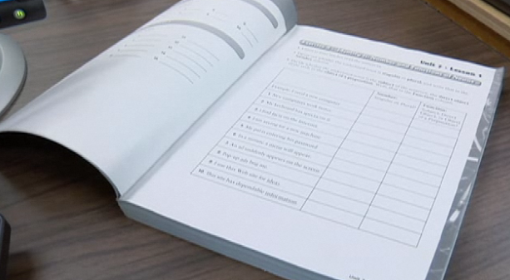
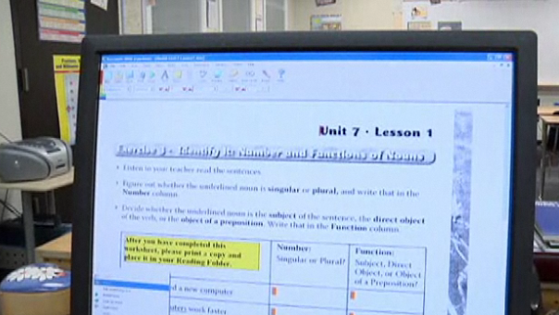
2) Scanning your own text
Paper text
Scan the text
Digital text
Notes:
Paper texts can be converted to digital texts using a scanner and specialized software.

Slide 21
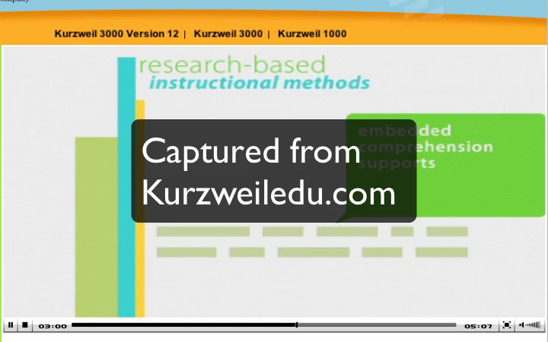
2) Scanning a text with Kurzweil 3000

Slide 22
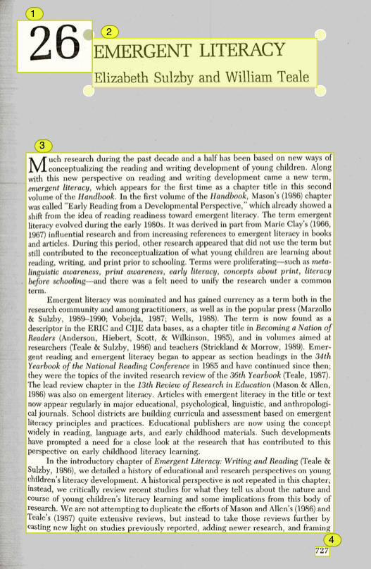
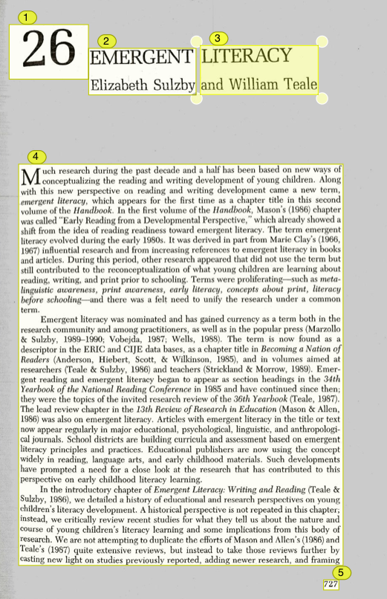
Fixes of the optical character recognition are sometimes necessary

Slide 23
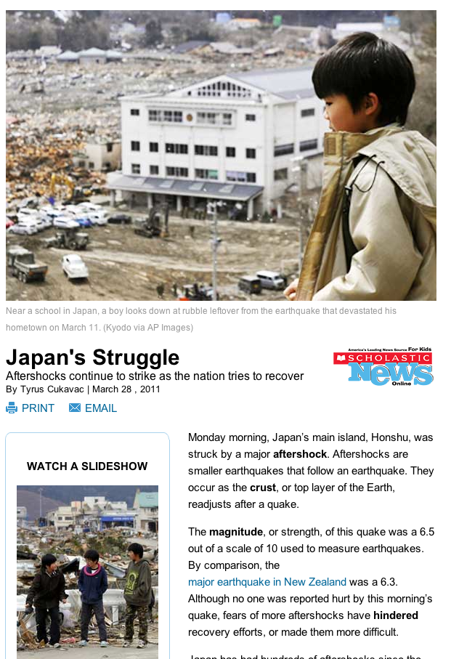
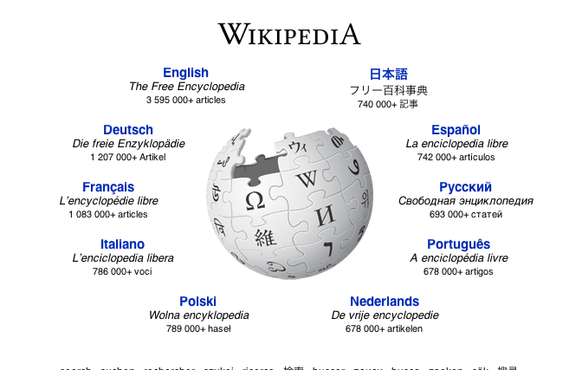
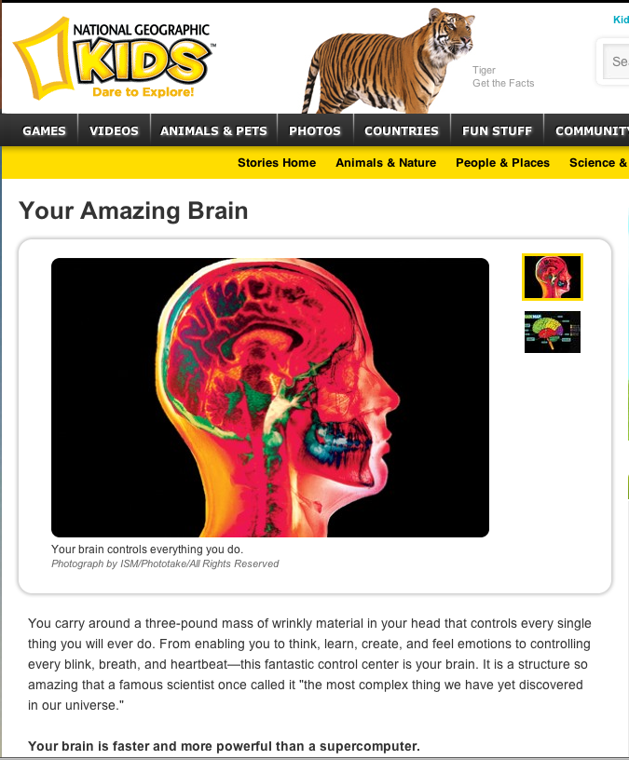
3) Digital texts on the internet
Wikipedia
Scholastic News
National Geographic

Slide 24
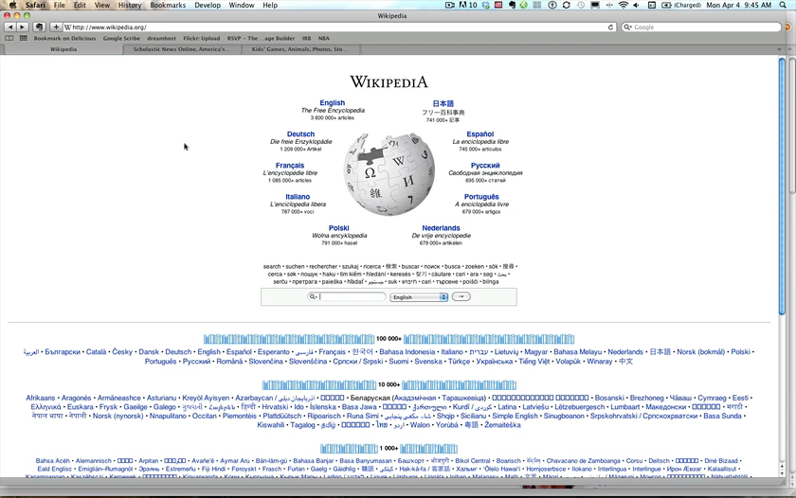
3) Digital texts on the internet

Slide 25
4) Digital texts in consumer formats
Amazon Kindle
Apple iPad
iBooks

Slide 26
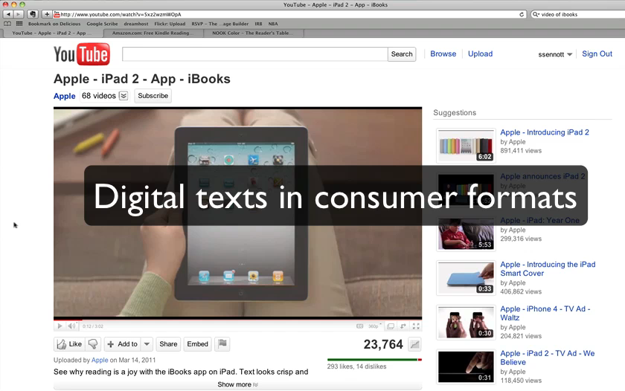
4) Digital texts in consumer formats

Slide 27

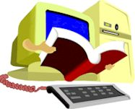
5) Digital text repositories
RFB&D
Bookshare
by Benetech
Accessible Book Collection

Slide 28
Bookshare

Slide 29
What is Bookshare
Bookshare® is an online library of digital books for people with print disabilities. It operates under an exception to U.S. copyright law which allows copyrighted digital books to be made available to people with qualifying disabilities.

Slide 30

Who qualifies for Bookshare?
Click here to watch a five minute video:
http://www.bookshare.org/assets/guides/who-is-eligible/lib/playback.html

Slide 31
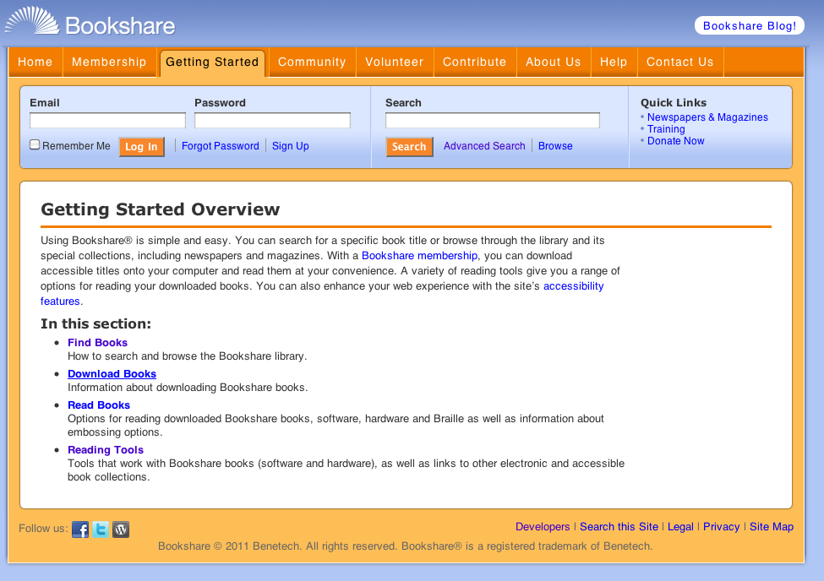
More Bookshare Resources
http://www.bookshare.org/_/gettingStarted/overview

Slide 32
What would this look like for Sarah?

Slide 33
Identify needed resources and impact
- cost?
- training (student and team)
Try 3 approaches
  Reading the text without any tools
  Try listening to the text as an audio file.
  Try using a text to speech tool like Kurzweil 3000 or Read and Write Gold.

Slide 34
Take action
Try Kurzweill with Sarah
Collect Data
  Observe her usage
  Chapter quizzes
    Vocabulary
    Content
  Sarah’s like/dislike of technology
  Application level assessment: writing, synthesizing, applying
Notes:
Hopefully we will have an opportunity to celebrate success

Slide 35
For more information
PowerPoint + PowerTalk, fullmeasure.co.uk/powertalk
MS Word and Word Talk, www.wordtalk.org.uk
Tarheel www.tarheelreader.org
Bookbuilder, bookbuilder.cast.org
Kurzweil 3000, www.kurzweiledu.com
Read and Write Gold, www.texthelp.com
Wikipedia, www.wikipedia.org
Scholastic News, www2.scholastic.com/browse/scholasticNews.jsp
National Geographic Kids, www.kids.nationalgeographic.com
Kindle, https://kindle.amazon.com
iBooks, www.apple.com/ipad/built-in-apps/ibooks.html
Nook, www.barnesandnoble.com/nook
Bookshare, www.bookshare.org
Project Gutenberg, www.gutenberg.org
The Accessibile Book Collection, www.accessiblebookcollection.org
UDL Tech Toolkit, http://udltechtoolkit.wikispaces.com

Slide 36
Resources From CAST
CAST: www.cast.org
Teaching Every Student in the Digital Age eBook by David Rose and Anne Meyer: http://www.cast.org/teachingeverystudent/ideas/tes/
Digital Text Links: http://www.cast.org/teachingeverystudent/ideas/presentations/digitaltext_links.cfm

Slide 37
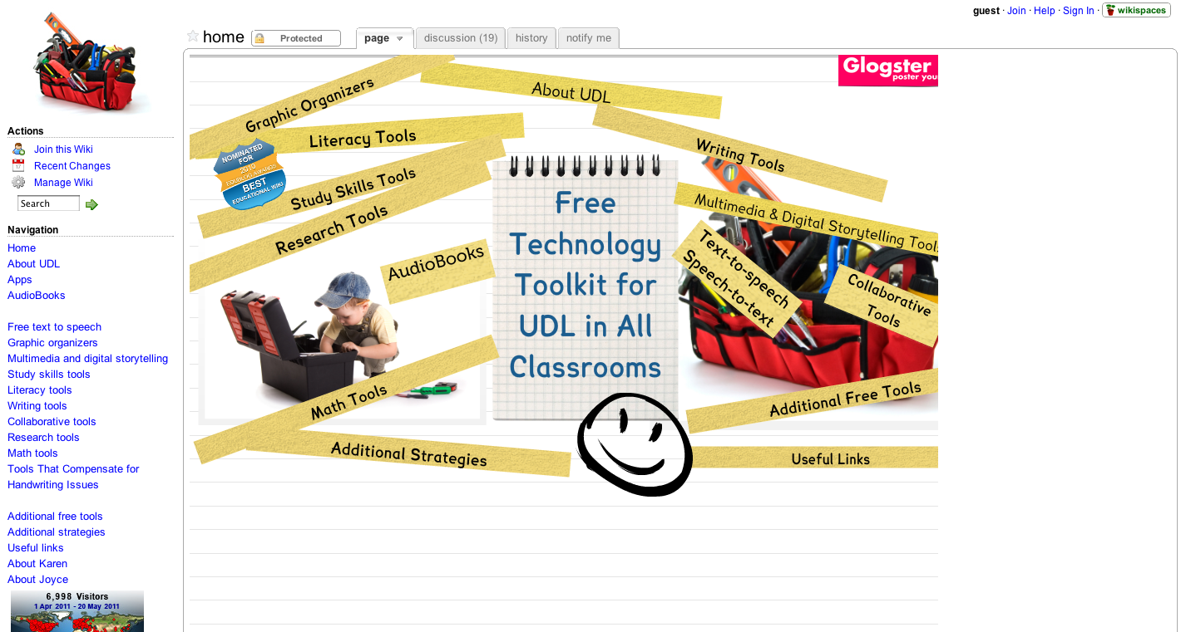
Free Digital Text Tools http://udltechtoolkit.wikispaces.com

