Slide 1

Reading and AT
Students with LD

Slide 2



Reasons for Reading
Personal enjoyment
Education
Work

Slide 3
DOIT! | SETT
Describe goal | Student? Environment? Task?
Outline alternatives | Tools?
Identify needed resources and impact - cost? - training (student and team)
Take action - select technologies identify responsibilities collect data
! Celebrate progress/success
Notes:
Goal is participation
Standards in reading, writing, and communication apply to students with disabilities the same as everyone else
Goals are challenging, and will require effort
first step, as in any problem-solving situation, is to think about why the goal is important, and how to measure progress towards the goal

Slide 4
1) Describe Goal
Student, environment, task
  14 year old with learning disability
    Interested in skate boarding and music
  Participate in a wide variety of environments
    Academic, social
    Plan for post-secondary
  Reading: Obtain meaning from print
    Text books, reading for pleasure
    Internet
    Note-taking and reading notes
Notes:
What can be done to promote access to text?

Slide 5
2) Outline Alternatives
Handheld device for words
Books on tape
Digital text (commercially produced)
  Downloadable digital text (e.g., Bookshare)
  Specialized scanning software (convert printed materials to digital text)
  Commercial products (e.g., Kindle)
  UDL textbook
Digital text (self-created)
Notes:
Obtain meaning from print

Slide 6
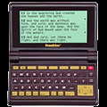
3) Identify Resources and Impact
Handheld device for words
  Franklin Talking Dictionary
+ access to a wide range of materials
+ independence
Fluency?

Slide 7

3) Identify Resources and Impact
b) Books on tape
+ access to a wide range of materials
long-term cost?
  Aide/volunteers
independence?
  test-taking

Slide 8
3) Identify Resources and Impact
C) Digital texts (commercially produced)
  BookShare
  Scanners (e.g., Kurzweil 3000)
  Kindle
  UDL Texts

Slide 9
3c1) Bookshare
Please click this link to view video of Shane McKnight
Please click below to advance webcast presentation after you have viewed the video.

Slide 10
3) Identify Needed Resources and Impact
3c1) Downloadable Digital Texts
  • Bookshare
  + Thousands of downloadable books
  + Free if student has a registered print disability
  - Match of texts with student interest, curriculum goals

Slide 11
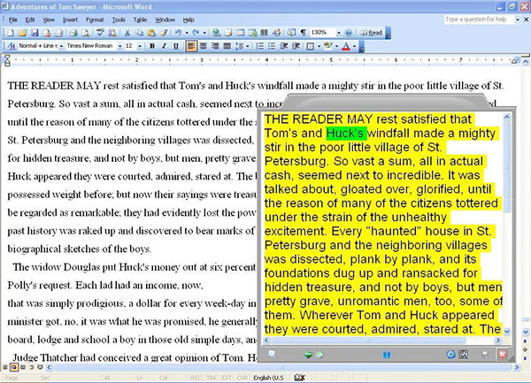
3) Identify Needed Resources and Impact
3c2) Specialized scanning software
+ Access to a wide range of materials
Cost of device
Time to create materials

Slide 12
3c2) Kurzweill
Click here to view demonstration of Kurzweill video
This video will open in a new screen
Please click below to advance webcast after you have viewed the video

Slide 13
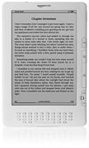
3c3) Kindle
Please click here to view demonstration of Kindle
This video will open in a new screen
Please click below to advance webcast after you have viewed the video

Slide 14
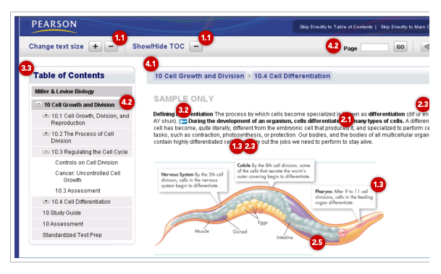
3c4) Textbooks UDL

Slide 15
4) Take action
Review choices, select technologies
  How to best work towards academic goals
Identify responsibilities
  Who is going to do what, and when
Collect data
  Academic progress
  Enjoyment of activity
  Independence
Notes:
Having people read aloud helped them realize desired featrues of tech
Tranig lead to Independence
Academic progress and enjoyment of reading

Slide 16
5) Celebrate Success!
Encourage student to reflect on progress on specific task
Share good news
  Parents
  Other teachers
  Administrators

Slide 17
Supports and Resources
Supports
  Special Education Teacher
  Intermediate Unit AT specialist
Resources
  http://www.bookshare.org/
  http://www.cast.org/index.html

Slide 18
DOIT! | SETT
Describe goal | Student? Environment? Task?
Outline alternatives | Tools?
Identify needed resources and impact - cost? - training (student and team)
Take action - select technologies identify responsibilities collect data
! Celebrate progress/success
Notes:
Goal is participation
Standards in reading, writing, and communication apply to students with disabilities the same as everyone else
Goals are challenging, and will require effort
first step, as in any problem-solving situation, is to think about why the goal is important, and how to measure progress towards the goal

